Slide 1


Ayotunde Oyewole
June 10, 2024

Slide 2

Outline
Executive Summary
Introduction
Methodology
Results
Conclusion
Appendix

Slide 3
Executive Summary
Summary of methodologies
This project was an analysis of SpaceX Falcon 9 data to predict whether the its first stage would land successfully. The project started with a detailed exploration and a creation of the analytic base table using pandas. Interesting visuals were created as part of the project that helped to identify relevant insights about Falcon 9 launches, conditions favorable to successful landing etc.
Summary of all results
The culmination of the project was the creation of four classification models – KNN, SVM, Logistic regression, and decision tree. The decision tree classifier had the best result, with an accuracy score of 88.8% on test data.

Slide 4
Introduction
Project background and context
Space X advertises Falcon 9 rocket launches on its website with a cost of 62 million dollars; other providers cost upward of 165 million dollars each, much of the savings is because Space X can reuse the first stage. Therefore if we can determine if the first stage will land, we can determine the cost of a launch. This information can be used if an alternate company wants to bid against space X for a rocket launch.
Problems you want to find answers
The main problem that this project attempts to solve is to help space exploration companies to determine if conditions are right for their spaceship to land successfully. If they can optimize the recovery and successful landing of their spaceship, it will result in significant cost savings.

Slide 5

Section 1

Slide 6
Methodology
Executive Summary
Data collection methodology:
The project started with collection of data from the SpaceX API. The data for falcon 9 was filtered out and parsed into a Pandas data frame; and then cleaned.
Perform data wrangling
The training labels were created with 1 indicating a successful launch and 0 meaning unsuccessful.
Perform exploratory data analysis (EDA) using visualization and SQL
Perform interactive visual analytics using Folium and Plotly Dash
Perform predictive analysis using classification models
Classification algorithms from sklearn were used to build the models. All four models were evaluated and compared based on their accuracy scores.

Slide 7
Data Collection – SpaceX API
A get request was made to SpaceX’s rest API. The content of the request was then parsed into a pandas data frame using the json normalize function. The required data was filtered out by column and dates.
The notebook on data collection is available at https://github.com/asoyewole/IBM-Data-Science-Capstone-Project/blob/main/jupyter-labs-spacex-data-collection-api.ipynb
Get request – json normalize – data filtering (date, columns.
7

Slide 8
Data Wrangling
Null records were identified on the landing pad column and handled. Subsequently, a column was engineered which classified bad landing outcomes from positive outcomes.
The notebook for the data wrangling is available at https://github.com/asoyewole/IBM-Data-Science-Capstone-Project/blob/main/labs-jupyter-spacex-Data%20wrangling.ipynb

Slide 9
EDA with Data Visualization
Pairing up matplotlib and seaborn, some plots were developed to help understand the data. The relationship between flight number and launch site was plotted as a scatterplot. The top orbit types based on average class was identified using a horizontal bar chart. Aside other scatterplots, one other important visual was the trend of success rate by year which showed a continuous growth with few troughs.
The notebook for the data visualization is available at https://github.com/asoyewole/IBM-Data-Science-Capstone-Project/blob/main/edadataviz.ipynb

Slide 10
EDA with SQL
Using SQL, a detailed exploration of the data was completed. Items like unique names of launch sites, total number of landing outcomes for each landing outcome, booster version that have the maximum payload mass etc. Screenshots of some sample queries are presented below.
The notebook for the SQL data exploration is available at https://github.com/asoyewole/IBM-Data-Science-Capstone-Project/blob/main/jupyter-labs-eda-sql-coursera_sqllite.ipynb

Slide 11
Build an Interactive Map with Folium
A number of interactive maps were designed to explore the locations of the launch sites and how the locations and geographic proximities affect or impact successful landing.
The notebook for the interactive map designed with folium is available at https://github.com/asoyewole/IBM-Data-Science-Capstone-Project/blob/main/lab_jupyter_launch_site_location.ipynb

Slide 12
Build a Dashboard with Plotly Dash
Two interactive plots were included on the dash app – a pie chart showing the ratios of successful launches for each site, and a scatterplot that shows the interaction between the payload mass and the class.
The python script for building the dash interactive app is available at https://github.com/asoyewole/IBM-Data-Science-Capstone-Project/blob/main/spacex_dash_app%20(1).py

Slide 13
Predictive Analysis (Classification)
The data was split into features and target, and then scaled as is required for classification models. Both the features and the target was split into training and testing data. A grid search algorithm was used to tune the hyperparameters for each model. Logistic regression, KNN, SVM, and Decision Tree models were each fitted to the training data, and then tested using the test data.
The notebook for the classification analysis is available at https://github.com/asoyewole/IBM-Data-Science-Capstone-Project/blob/main/SpaceX_Machine%20Learning%20Prediction_Part_5.ipynb

Slide 14

Section 2

Slide 15
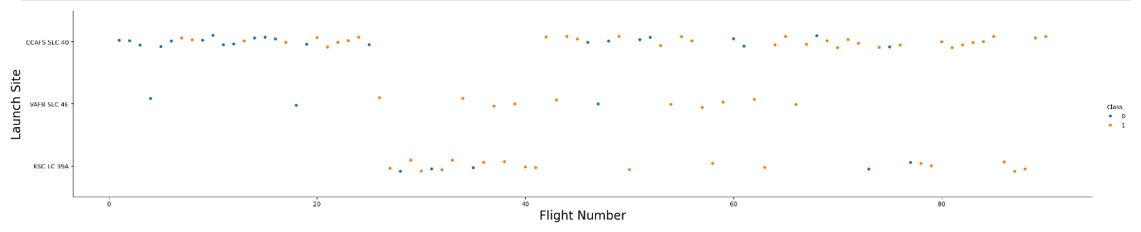
Flight Number vs. Launch Site
There were more of class 0 launches at the CCAFS SLC 40 while class 1 launches are spread out between all three launch sites. VAFB SLC 4E had fewer flights compared to the other sites. In a similar vein, CCAFS SLC 40 had the most number of flights.

Slide 16
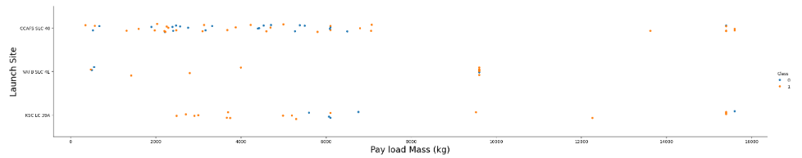
Payload vs. Launch Site
It is notable here that there are no rockets launched for heavy pay load greater than 10 thousand kg for VAFB-SLC launch site.

Slide 17
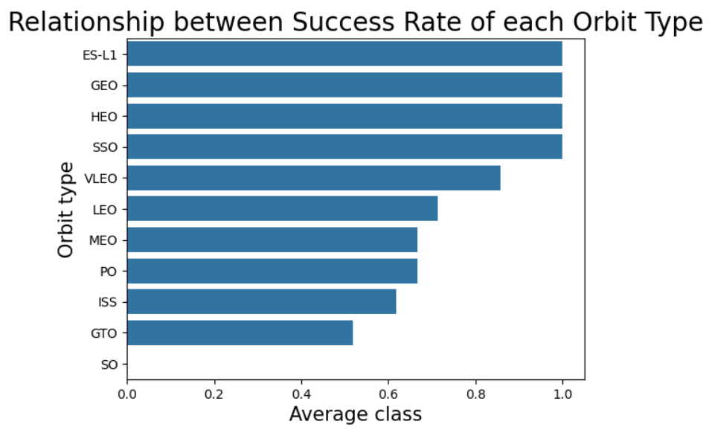
Success Rate vs. Orbit Type
ES-L1, GEO, HEO and SSO all had 100% success rates. On the other hand, SO, recorded no success at all while MEO, PO, ISS and GTO had success rates below 0.7. LEO and VLEO had successes between 0.7 and 0.9.

Slide 18
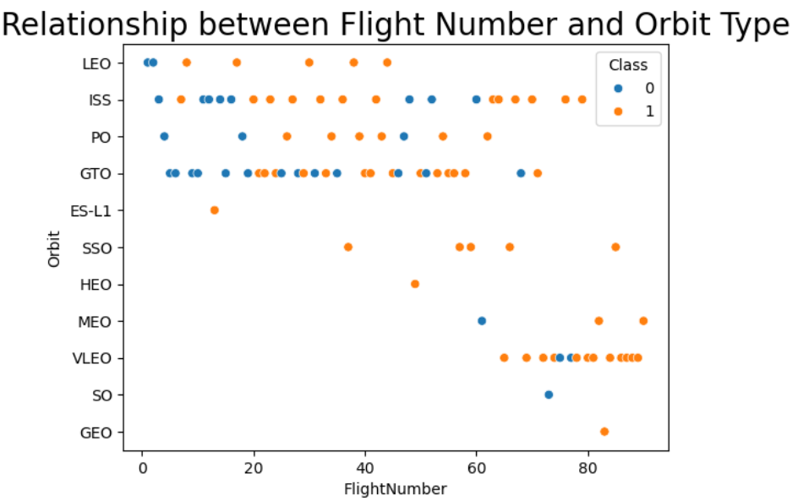
Flight Number vs. Orbit Type
the LEO orbit the Success appears related to the number of flights; on the other hand, there seems to be no relationship between flight number when in GTO orbit.

Slide 19
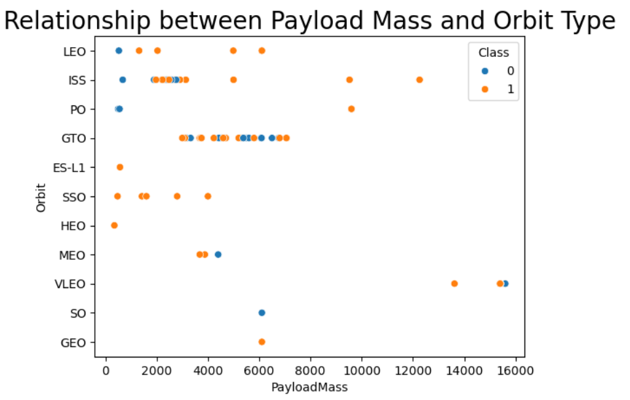
Payload vs. Orbit Type
With heavy payloads the successful landing or positive landing rate are more for Polar, LEO and ISS.
However for GTO we cannot distinguish this well as both positive landing rate and negative landing(unsuccessful mission) are both there here.

Slide 20
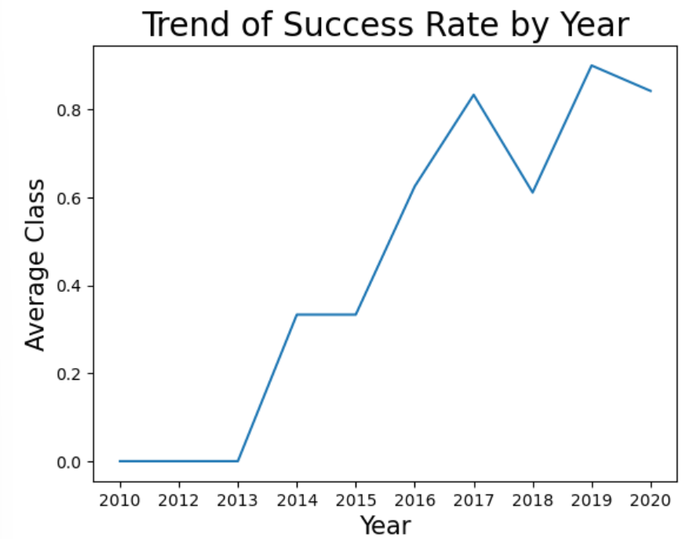
Launch Success Yearly Trend
the sucess rate since 2013 kept increasing till 2020

Slide 21
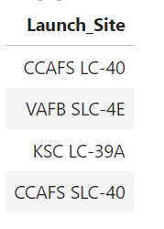
All Launch Site Names
The table shows the names of all the launch sites.

Slide 22
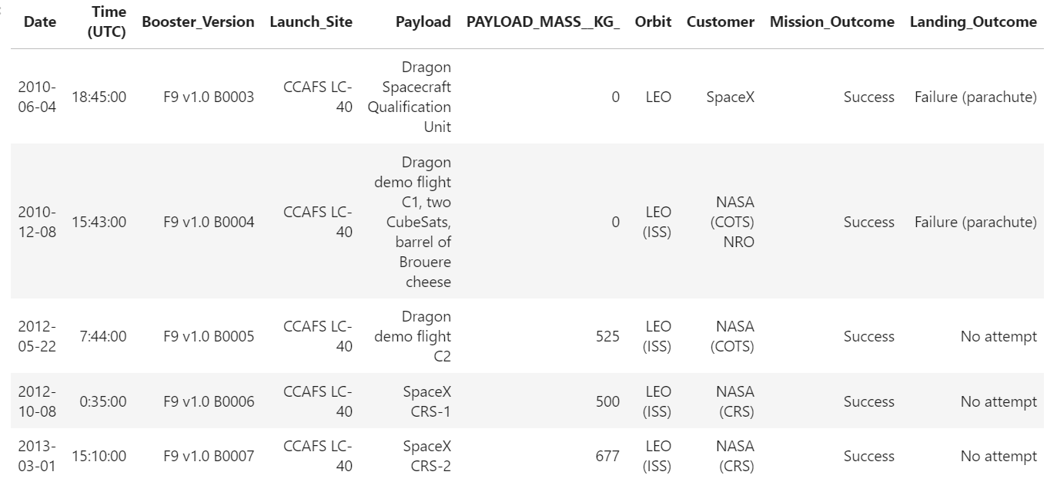
Launch Site Names Begin with 'CCA'

Slide 23
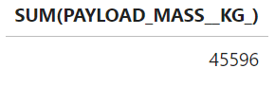
Total Payload Mass

Slide 24
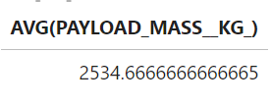
Average Payload Mass by F9 v1.1

Slide 25
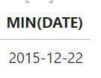
First Successful Ground Landing Date

Slide 26
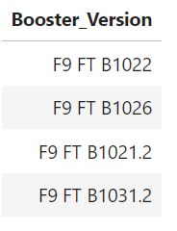
Successful Drone Ship Landing with Payload between 4000 and 6000

Slide 27
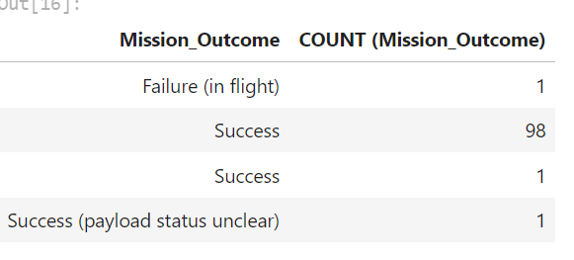
Total Number of Successful and Failure Mission Outcomes

Slide 28
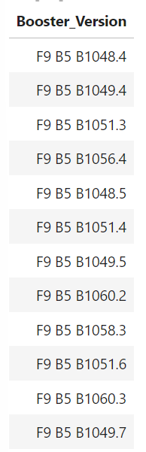
Boosters Carried Maximum Payload

Slide 29
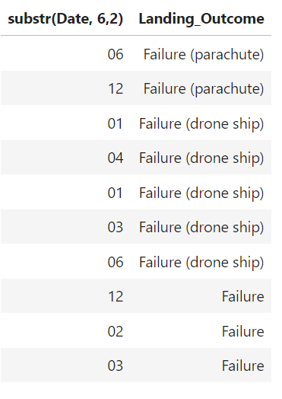
2015 Launch Records

Slide 30
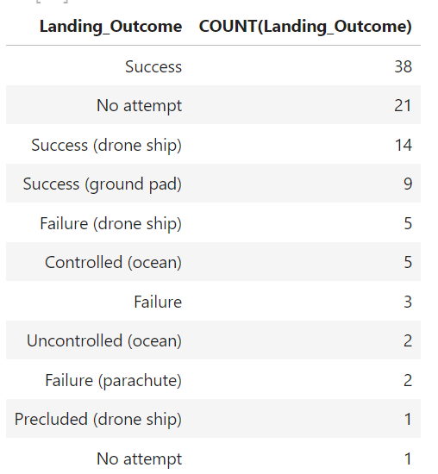
Rank Landing Outcomes Between 2010-06-04 and 2017-03-20

Slide 31

Section 3

Slide 32
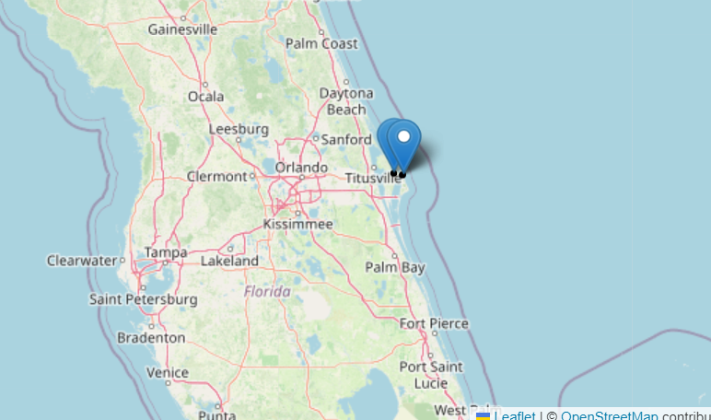
Labelled Launch Locations

Slide 33
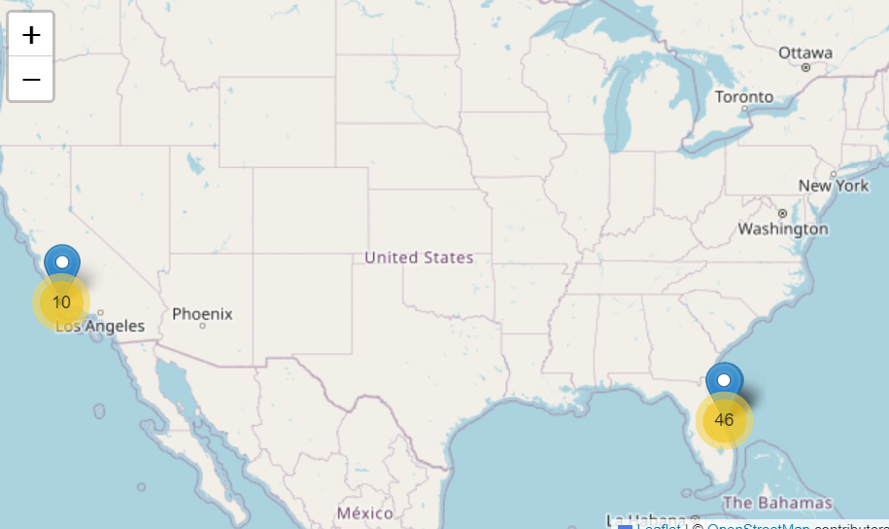
Launch Map with Proximities

Slide 34
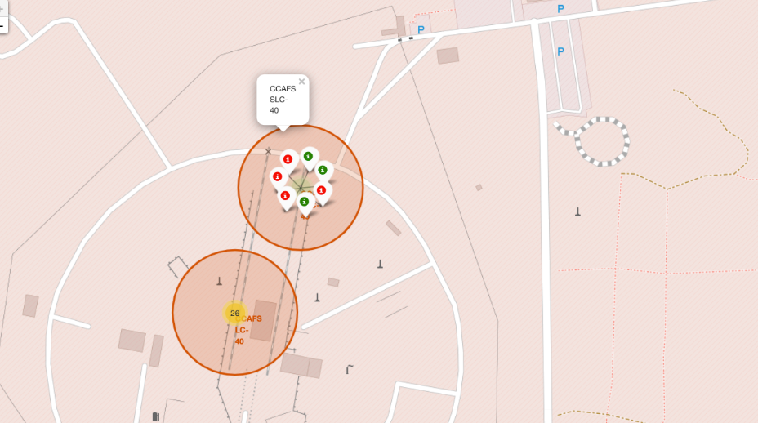
Successful Launches for Sites

Slide 35

Section 4

Slide 36
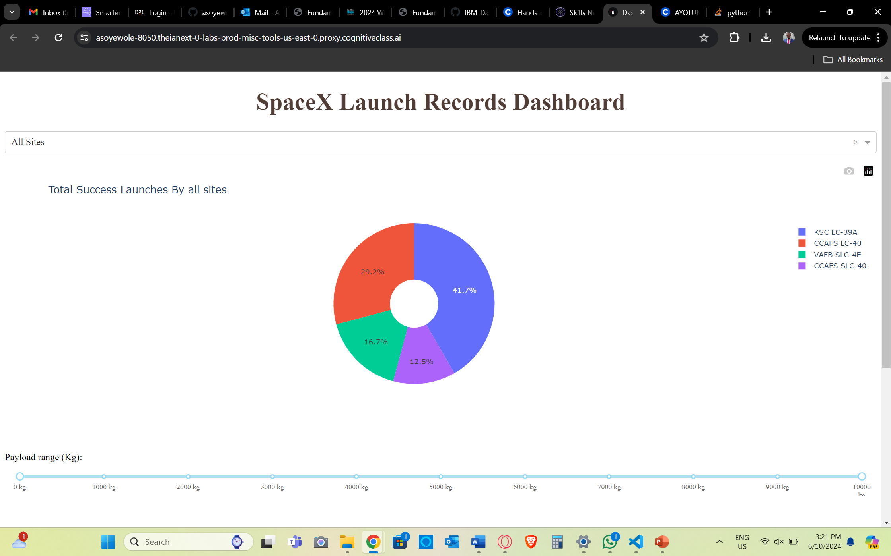
Total Successful Launches of all Sites
KSC LC-39A had more than a third of the successful launches. Only 12.5% were successful in CCAFS SLC-40.

Slide 37
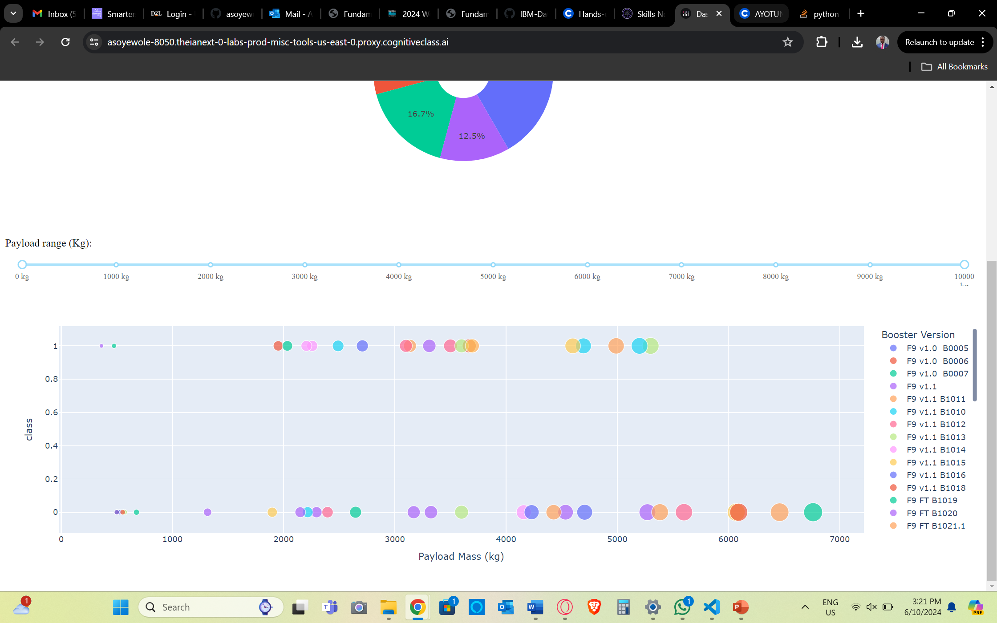
Relationship between Payload and Launch Outcome
The plot shows the relationship between payload and launch outcomes.

Slide 38

Section 5

Slide 39
Models | Accuracy
KNN | 83.33%
Decision Tree | 88.89%
SVM | 83.33%
Logistic Regression | 83.33%
Classification Accuracy

Slide 40
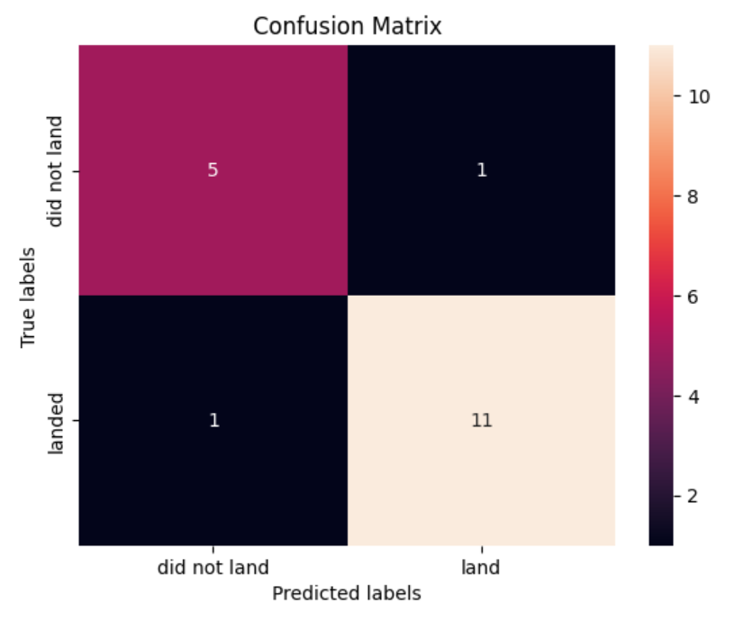
Confusion Matrix
The decision tree model was the best performing. The confusion matrix shows that it correctly classified 5 unsuccessful landings, and 11 successful landings. Only 1 each were misclassified and false positives and false negatives respectively.

Slide 41
Conclusions
This project involved the demonstration of a gamut of data science tools including SQL, python, visualization with folium, and dash etc.
The final phase of the project was the development of four machine learning models to classify the outcomes of space ship landing attempts.
The decision tree model was the best performing model for this project.

Slide 42
Appendix
Include any relevant assets like Python code snippets, SQL queries, charts, Notebook outputs, or data sets that you may have created during this project

Slide 43


